Slide 1

Dubai Residential price prediction

Slide 2

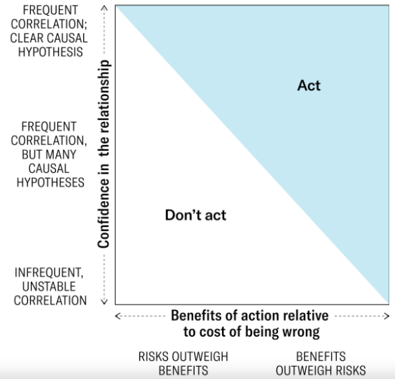
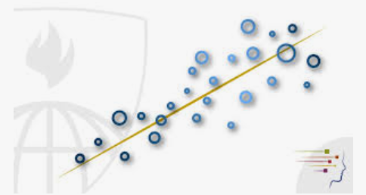
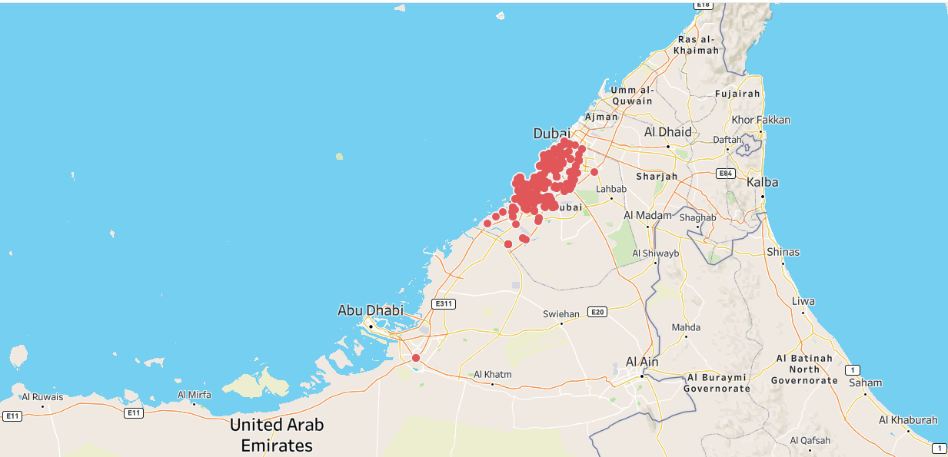
MEET OUR TEAM
Jae zakarauskas
Joanna gromek
Zunyan guo​
Peter austin​
Pandas Library
Regression Analysis
Machine Learning
VP Marketing

Slide 3
AGENDA
Introduction​ (Objective/Analysis Tools)
​Prediction Models Applied
Data Cleaning
Regression Analysis
Pandas Library
Tableau Visualizations
Conclusions​

Slide 4
Introduction
Predicting housing prices dataset based on data from Kaggle containing 80,000+ housing transactions dated January-June 2023 for Dubai, UAE. The objective is to determine if there is a relationship between Dubai house market prices and demand. The data contains a lot of transactional data that will enable us to build relations between property median values, median sizes, number of buyers, number of sellers in any given month.
We will perform the price prediction using the following machine tools/techniques:
Regression Analysis
Pandas Library
Tableau Visualizations
Machine Learning(if available)

Slide 5
Prediction Models

Slide 6
Regression analysis

Slide 7
Regression analysis

Slide 8
Pandas library

Slide 9
Pandas library

Slide 10
Tableau visualizations

Slide 11
Tableau visualizations

Slide 12
Machine learning(if needed)

Slide 13
Machine learning(if needed)

Slide 14
Conclusion
Observations
OPPORTUNITIES
There is no correlation between ………
Data used was………………..
Market for housing in Dubai is ………
Any other……………………
Data lacked coordinates for all properties listed…….
Given time we could develop a website or app for users to access on the go…….
Any Other…………..

Slide 15
THANK YOU
Instructional Staff (Will, Erin, Andrew, Anki)
All our Boot Camp Class Mates
Project 4 Team

